Slide 1
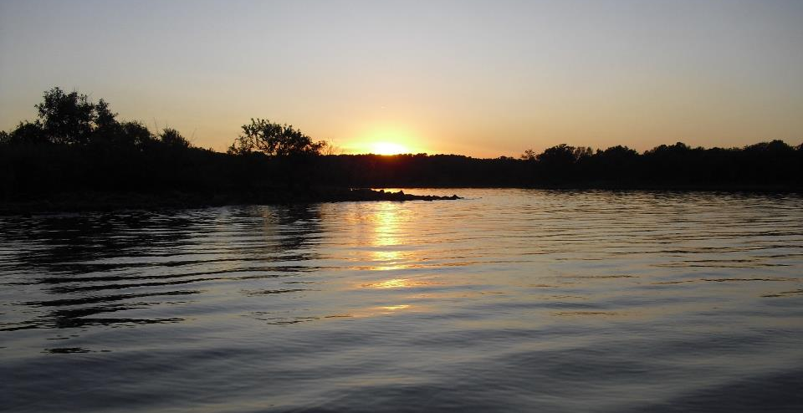
Part IV Monitoring: 303(d) TMDLs and Priority Areas
GCSA Workshop
OKR04 MCM-3 and Part IV Sampling and Field Methods
Presented by INCOG
Nienhuis Park
May 18, 2022

Slide 2

Overview of Impaired Waters (303d)
How 303(d) relates to Oklahoma’s WQS and DEQ’s Integrated Report

Slide 3
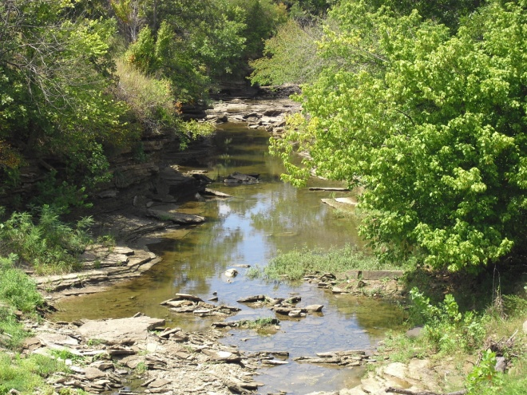
Oklahoma WQS Beneficial Uses
Public and Private Water Supply
Emergency Water Supply
Fish and Wildlife Propagation
    Habitat Limited Aquatic Community
    Warm Water Aquatic Community
    Cool Water Aquatic Community
    Trout Fishery (put and take)
Recreation (Primary & Secondary Body Contact)
Agriculture
Aesthetics
Navigation
Fish Consumption
Oklahoma WQS use narrative and numeric criteria to protect Beneficial Uses. 303(d) is based upon not meeting one or more Beneficial Uses.

Slide 4
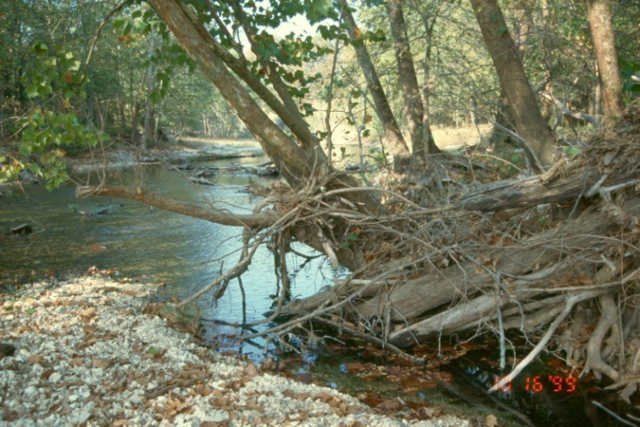
303(d) Impairment
Nonattainment of one or more Beneficial Uses can be caused by:
Dissolved oxygen, nutrients
Toxics (metals, organics, pesticides, “unknown”)
Sediment, suspended solids, turbidity
Pathogens (bacteria)
Biological (fish, macroinvertebrates)
pH
Oil & grease
Chloride, sulfate, TDS

Slide 5
The Oklahoma 303(d) List
2020 is the latest Integrated Report and 303(d) List; approved July 2021.
2022 Integrated Report draft expected to be final ~July 2022.
Biennial process (every 2 years, 2020 is the process start date).
Science-based. Formal sampling required.
Uses the OWRB’s Chapter 45 WQS and Chapter 46 303(d) assessment procedures.
DEQ coordinates the assessments and prepares the report.
303(d) impairments apply to the WQS Beneficial Uses.
Most waterbodies remaining 303(d) will have TMDLs.
A few will have “Watershed Based Plans” in lieu of TMDLs.

Slide 6
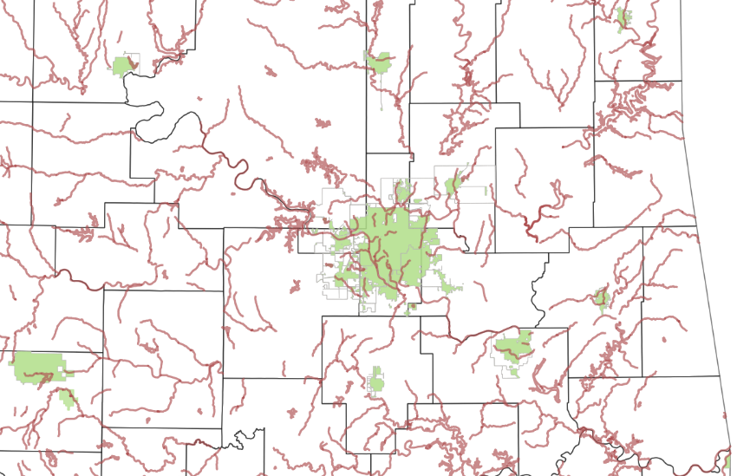
2020 303(d) Waters By GCSA Member MS4s
All GCSA Member MS4s have at least one 303(d) impaired waterbody within or adjacent to their MS4.
OKR04’s Part IV.A “Special Conditions” has most of OKR04’s 303(d) requirements.

Slide 7
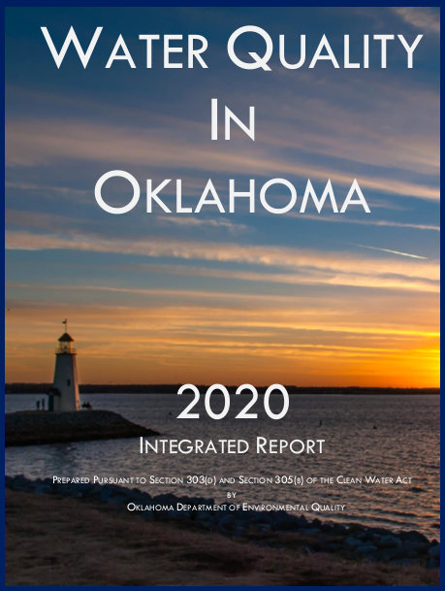
2020 Integrated Report and Appendices from DEQ Website
2020 Integrated Report
2020 Appendix A – WBID System
2020 Appendix B – 305(b) Comprehensive Waterbody Assessment
2020 Appendix C – 303(d) List of Impaired Waters
2020 Appendix D – Delisting Justifications
2020 Appendix E – Completed TMDLs
2020 Appendix F – Probabilistic Monitoring
2020 Appendix G – Nutrient Threatened Evaluation
2020 Integrated Report Public Notice
EPA Region 6 Approval Letter for the 2020 Oklahoma 303(d) List
EPA Region 6 2020 Oklahoma 303(d) List Decision Document
Public Solicitation of Water Quality Data for the 2020 Integrated Report

Slide 8
Integrated Report Categories 1-3
Category 1 – “Attaining the water quality standard and no use is threatened.”
  Rare; few waterbodies have sufficient data to show full attainment.
Category 2 – “Attaining some of the designated uses; no use is threatened; and insufficient or no data and information is available to determine if the remaining uses are attained or threatened.”
  Some data shows some attainment, but more data is needed.
Category 3 – “Insufficient or no data and information to determine if any designated use is attained.”
  Not enough data exists to assess any Beneficial Use attainment.

Slide 9
Integrated Report Category 4
Category 4 – “Impaired or threatened for one or more designated uses but does not require the development of a TMDL.”
Category 4 also has 3 sub-categories:
  4a – “TMDL has been completed.”
  4b – “Other pollution control requirements are reasonably expected to result in the attainment of the WQS in the near future.”
  4c – “Impairment is not caused by a pollutant.”
A waterbody is still impaired even though the TMDL has been completed. Water quality data must show non-impairment.
There are some WBID segments in the IR that have a completed TMDL but are not listed as Category 4a. (recent WQ data = not impaired)

Slide 10
Integrated Report Category 5
303(d) impairments are Category 4 or 5 in Appendix C (“2020 Oklahoma 303(d) List of Impaired Waters”).
Category 5 – “The water quality standard is not attained. The waterbody is impaired or threatened for one or more designated uses by a pollutant(s) and requires a TMDL.”
Category 5 has 3 sub-categories:
  5a – “TMDL is underway or will be scheduled.”
  5b – “A review of the WQS will be conducted before a TMDL is scheduled.”
  5c – “Additional data and information will be collected before a TMDL or review of the WQS is scheduled.”

Slide 11
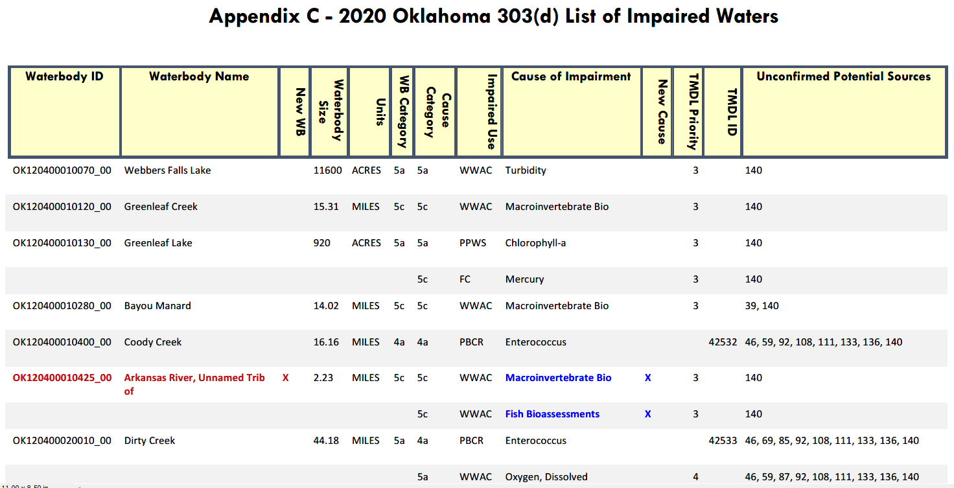
Example of Appendix C 303(d) Listings

Slide 12
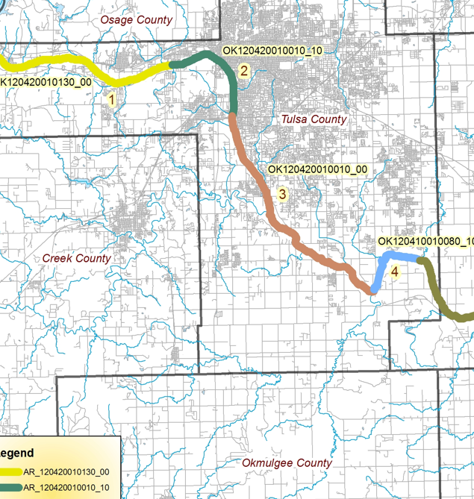
How To Know If Your MS4 Has 303(d)
Not all waterbodies in Oklahoma have WBID numbers.
Only WBID waterbodies are 303(d) candidates.
All 303(d) listings are in the Integrated Report (IR).
Don’t search the IR by name of stream or lake.
WBID codes are unique to each WBID segment.
Larger streams and rivers have several WBID segments.
The IR 303(d) list does not indicate location of the segment.
GIS mapping is required: Local or DEQ Data Viewer

Slide 13
GCSA Members’ 2020 303(d) POCs
 | 2020 303(d) Parameters on MS4 Potential 303(d) Impaired Waters
GCSA Members | EN | EC | Turb | Fish | MI | DO | Hg | Pb | Cd | Dzn | Diel | TDS | SO4 | Chla | NO3 | Cl- | Sed | Phos
Arkoma | x |  | x
Bartlesville | x | x |  | x | x
Bixby | x | x | x | x | x | x | x | x |  | x
Broken Arrow | x | x | x | x | x | x |  | x |  | x |  | x
Catoosa | x |  | x |  | x |  |  |  |  |  |  | x
Claremore | x | x | x | x | x | x |  |  |  |  |  |  | x | x
Coweta | x
Creek County | x | x |  |  | x | x
Edmond | x |  | x | x | x |  | x |  |  |  |  |  |  | x | x
Glenpool |  |  |  |  | x |  |  |  |  |  |  |  |  |  |  | x
Jenks | x | x | x |  | x | x |  | x
Jones | x |  |  |  |  | x |  |  |  |  | x |  | x
Kiefer |  |  |  |  |  |  |  |  |  |  |  |  |  |  |  | x
Miami |  | x |  |  | x | x |  | x |  |  |  | x | x
Muskogee | x |  |  | x | x
Okmulgee | x |  | x | x |  | x | x x | x |  |  |  |  |  |  |  |  | x
Owasso | x | x | x |  | x
Ponca City |  |  |  |  |  |  | x |  |  |  |  |  | x | x
Rogers County |  |  |  |  | x
Sand Springs | x | x | x | x |  | x | x |  |  |  |  |  |  | x |  | x
Sapulpa | x | x |  |  | x | x | x
Tahlequah | x | x |  |  | x |  |  |  |  |  |  |  |  |  |  |  |  | x
Tulsa | x | x | x | x | x | x |  | x | x | x |  | x
Tulsa County | x | x | x | x | x | x |  | x | x | x |  |  |  |  |  | x
Wagoner County |  | x |  |  | x |  |  |  |  |  |  | x

Slide 14

303(d) POC Statistics for 25 GCSA MS4s
286: total number of GCSA potential receiving waterbodies
208: total number of these listed as 303(d) impaired (73%)
18: number of these that are lakes (6%) (94% are streams and rivers)
18: number of different 303(d) POCs
79: number of the 208 impaired as 5a (28%) (TMDL in progress or scheduled)
15: number of the 208 impaired as 5b (5%) (WQS review before TMDL)
68: number of the 208 impaired as 5c (24%) (collect more data before TMDL)
46: number of the 208 impaired as 4a (16%) (TMDL has been completed)
Percent of GCSA members having to address the 18 303(d) POCs:
Enterococcus | 76% | Mercury | 27% | Sulfate | 16%
E. coli | 56% | Lead | 28% | Chlorophyll | 16%
Turbidity | 48% | Cadmium | 8% | Nitrates | 4%
Fish | 40% | Diazinon | 16% | Chloride | 16%
Macroinvert | 72% | Dieldrin | 4% | Silt/sediment | 4%
Diss. Oxygen | 48% | T. Diss. Solids | 20% | Phosphorus | 4%

Slide 15
Different POCs Mean Different Sources
Bacteria: pets, livestock, birds, rooftops, woodlands, agriculture, lawn clippings, dead animals, dumpsters, trash hauling, sewage bypasses, soil, wildlife areas, regrowth.
Metals: industry facilities, industrial waste, soils, landfills, cars, streets, airborne deposition, illegal dumping, batteries, mechanical wastes.
Salts: fertilizer overuse, chemical storage, oil and gas production, WWTP and industrial effluent, winter ice control, industrial facilities.
Nutrients / DO (complicated interaction): fertilizers, agriculture, livestock, pets, illegal dumping, woodlands, animal waste, soils, lawn clippings.
Pesticides: agriculture, lawn overuse, illegal dumping, chemical storage.
Silt / Sediment: construction sites, erosion, impervious surfaces.

Slide 16
Addressing 303(d) Impaired Waters (Part IV.A)
MS4 requirements to Protect 303(d) impaired waters

Slide 17
OKR04 Part IV Overview
Part IV addresses “Special Conditions and Compliance With Water Quality Standards” (WQS).
Part IV.A covers 303(d) impairment and WQS exceedances.
  Part IV.A.1 covers 303(d) with 8 subparts (items a. – h.)
  Part IV.A.2 covers WQS (single paragraph requiring DEQ notification).
Part IV.B refers to TMDLs (many pages).
Part IV.C refers to ORW (single paragraph).
  Only Tahlequah must comply with Part IV.C.
Part IV.A.1 303(d) and Part IV.B TMDL requirements will be addressed in this workshop presentation.

Slide 18
OKR04 Part IV.A.1 303(d) Requirements
IV.A.1: Implement and maintain BMPs that will ensure that 303(d) pollutants will not cause exceedances of WQS.
IV.A.1.a: Develop a Plan listing the BMPs to be implemented to reduce 303(d) POCs and how you expect the controls to reduce POCs.
IV.A.1.b: Your outreach programs must target sources likely to have significant impacts on 303(d) impaired waters.
IV.A.1.c: Identify the discharges that contribute significant pollutants to your impaired waters.
IV.A.1.d: You must locate areas most likely to have significant discharges of 303(d) pollutants.

Slide 19
Part IV.A.1 303(d) Requirements (cont.)
IV.A.1.d: You must conduct inspections of illicit discharges based upon your priority areas of your 303(d) waterbodies.
IV.A.1.e: You must include any Operation & Maintenance procedures for structural and non-structural 303(d) pollutant controls.
IV.A.1.f: You must assess 303(d) water quality impacts from new flood management projects.
IV.A.1.f: You must examine existing projects for possible additional water quality protection devices and practices.
IV.A.1.g: Use BMPs that manage 303(d) POCs.
IV.A.1.h: If the 303(d) pollutant is bacteria, OKR04 has 5 categories of pollution reduction BMP requirements to implement.

Slide 20
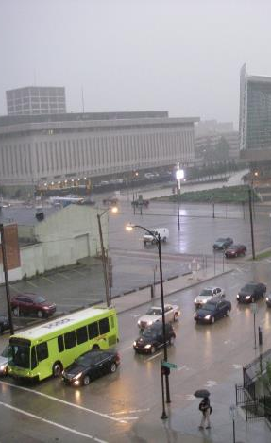
Interpreting OKR04’s 303(d) Inspection Requirements
There are only two Part IV.A.1 subparts that refer to some type of field investigations for 303(d) POC sources.
The remaining subparts of Part IV.A.1 deal with aspects of BMP implementation.
Part IV.A.1.c: “You must identify any non-stormwater discharges that contribute significant pollutants to your impaired waters.”
Part IV.A.1.d: “You must locate those areas likely to have illicit discharges and conduct inspections based on the priority areas in the watershed of your 303(d) listed waterbodies.”

Slide 21
Basis of 303(d) Investigations
Part IV.A.1.c: “You must identify any non-stormwater discharges that contribute significant pollutants to your impaired waters.”
What is meant by identifying discharges of POCs?
The SWMP Template uses a source-listing approach. For each 303(d) waterbody, SWMP Table 10 lists the POC and each potential significant source of the POC within the watershed.
In this approach, it is assumed OKR04 is wanting the MS4 to determine if any land uses and human activities within the 303(d) watershed are potential significant POC sources.

Slide 22
Basis of 303(d) Investigations
Part IV.A.1.d: “You must locate those areas likely to have illicit discharges and conduct inspections based on the priority areas in the watershed of your 303(d) listed waterbodies.”
What is meant by locating areas likely to have POC discharges and conducting inspections in priority areas?
The SWMP Template defers to MCM-3 monitoring and sampling requirements for DWFS and IDDE source tracking.
The SWMP Template has detailed procedures under MCM-3 for POC discharge discovery, confirmation, characterization and source tracking, most of which apply to Part IV.A.1 303(d) inspections as well as MCM-3 DWFS and IDDE.

Slide 23
303(d) Inspection Suggestions
OKR04 has no 303(d) inspection methods. Think DWFS.
Most MCM-3 illicit discharge discovery, confirmation, pollutant characterization and source tracking methods apply to the Part IV.A.1 303(d) requirements to investigate 303(d) POC discharges, including use of Priority Areas.
Define Priority Areas within each 303(d) watershed for each POC type (bacteria, metals, nutrients, etc.)
Different POCs may require different Priority Areas.
Locate sites based upon land uses likely to have POCs.
Prepare detailed written guidance or SOPs for all aspects of Part IV that involve repeatable activities (e.g., test kit use).

Slide 24
DWFS vs. 303(d) Inspections
Common To Both DWFS and 303(d) Inspections:
  Both use Priority Areas and land uses.
  Both rely on visual inspections with test kits.
  Both result in identifying pollutant sources.
DWFS Inspections Only:
  Only applies to inspecting during dry weather.
  Inspection sites focus on POC and MS4 outfalls.
  Address all pollutant discharges, not just 303(d).
  Table V-4 minimum DWFS inspection frequencies.
303(d) Inspections Only:
  Applies to just 303(d) POCs.
  No minimum inspection frequencies in OKR04.

Slide 25
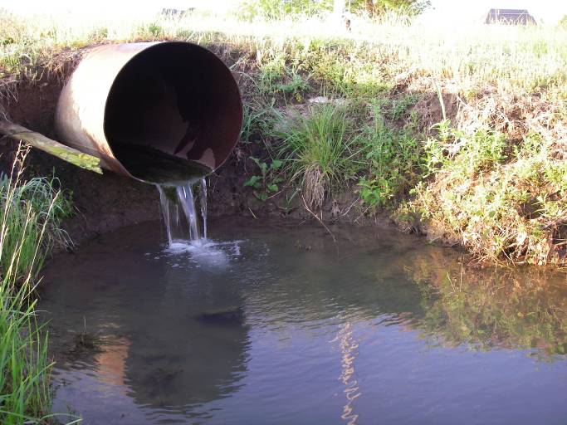
When To Go Out
303(d) inspections can be done in any season.
Normal business hours and workdays.
Plan for 6-10 sites per day at most.
Make time for prep, travel, making observations, paperwork.
303(d) inspections rely more on land uses, map data and Priority Areas.
Consider safety factors (temperature extremes, thick weeds, etc.)
OKR04 does not specify how to 303(d) inspect; use written procedures.

Slide 26
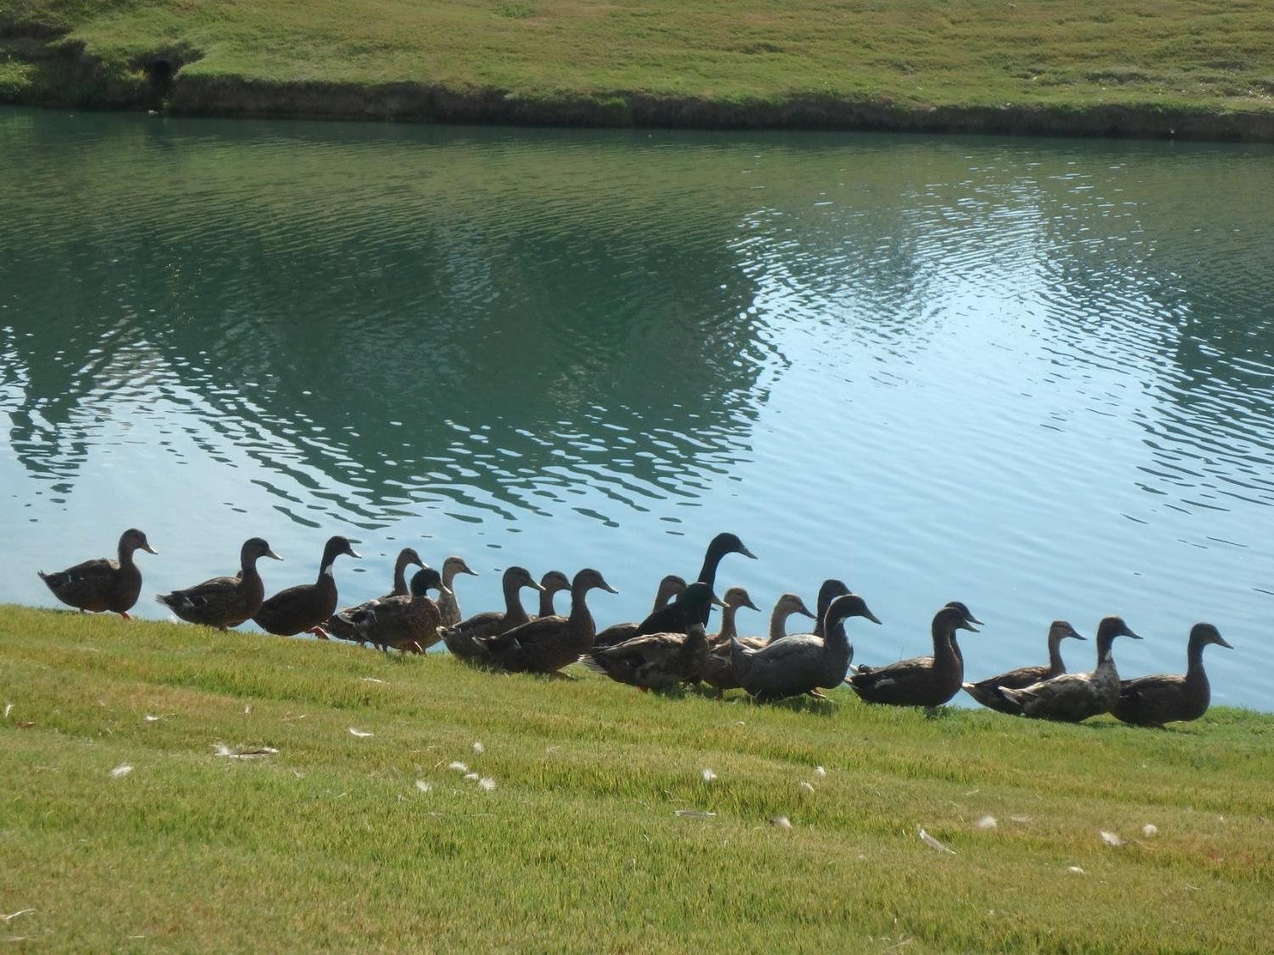
Play Detective
(same as DWFS)
Possible bacteria sources: Birds nearby? Confined animals? Septic systems? Sanitary sewer overflows or leaking pipes?
Is the turbidity coming from a nearby construction site? A parking lot or road? An industrial discharge?
Are algal “blooms” being caused by nutrient chemical discharges, residential over-fertilization or wildlife?
Is the dead vegetation caused from a toxic discharge?

Slide 27
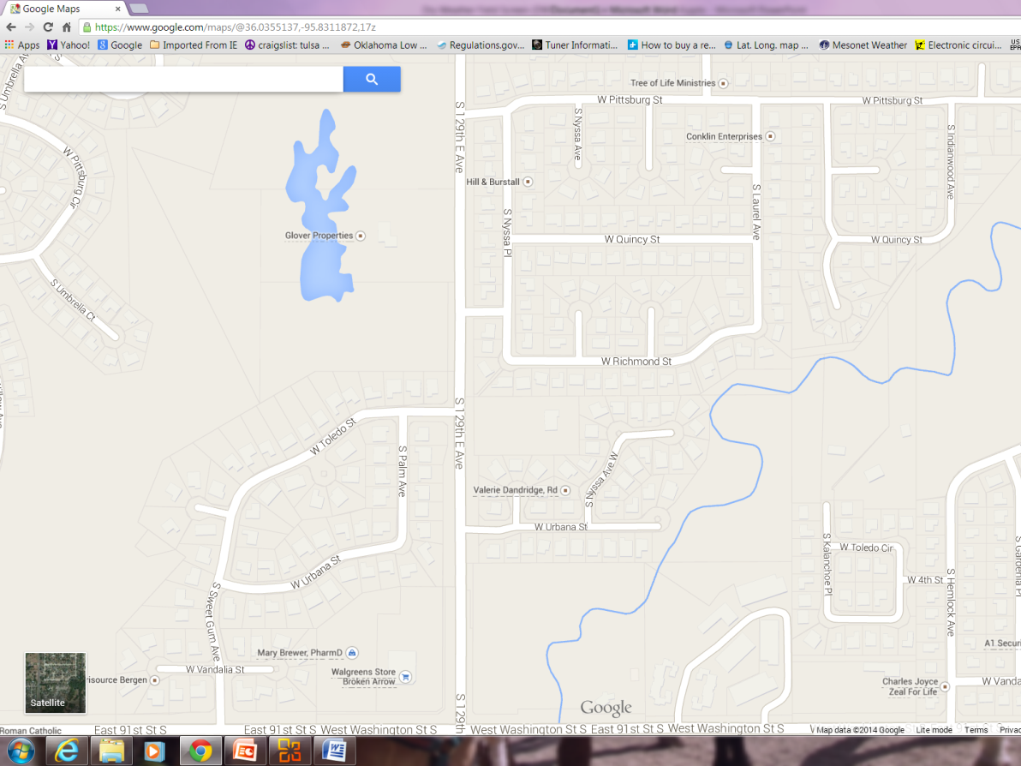
Existing Water Chemistry Data
(same as DWFS)
Sources of existing water chemistry data:
  From past MS4 testing.
  From state agencies (INCOG, DEQ, Blue Thumb, OWRB, etc.).
  Nearby water plants and wastewater plants.
Use this data to determine what is typical for surface waters in your MS4, for runoff flow discharges, and for wastewater effluent in your area.
Baseline data allows comparisons with future data.

Slide 28
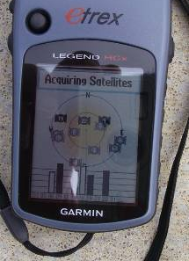
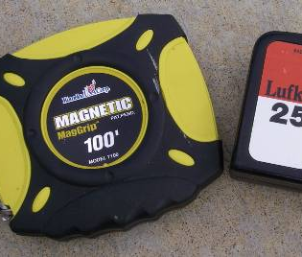
Inspection Site Location Records
  Record sites on a map and assign a Site Number.
  Take pictures of each site (initially and when there are changes).
  Obtain site map position “lat-long” coordinates (either by field GPS unit or from a GIS map).
  Obtain aerial photos of each site and surrounding land uses (paper or GIS).
  Make field distance measurements (tape measure, pacing or a visual estimate).

Slide 29
Season, Time of Day and Preparation
303(d) inspections for most POCs can be done in any season in daytime.
Seasonal Bacteria: WQS apply only between May 1 to Sept. 30.
Seasonal DO: WQS for DO are seasonal (spring, summer and winter WQS).
Time of Day: DO is heavily affected by diurnal cycle which affects data interpretation.
Plan for 6-10 sites per day at most, fewer if detailed activities or bottle-filling is needed.
Make time for pre-event prep, commute, observations, sampling and recordkeeping.

Slide 30
Spotting Potential POC Sources
FOREMOST: For each POC, know what potential sources to look for.
Develop a checklist of what you are seeking for each POC type.
Rely upon and focus your efforts in your Priority Areas.
Bacteria sources: Birds nearby? Confined animals? Septic systems? Sanitary sewer overflows or leaking pipes? Leaking dumpsters? Pets?
Turbidity: Track-out or erosion from construction sites? Concrete washout? An industrial discharge?
Nutrients and poor DO: Algal “blooms” in creeks or ditches? Fertilizer application? Yard waste in creeks? Discharge pipes?
Lab samples: Only needed to confirm POCs where the data will be needed for enforcement. Screening field test kits are suitable for most inspections.

Slide 31
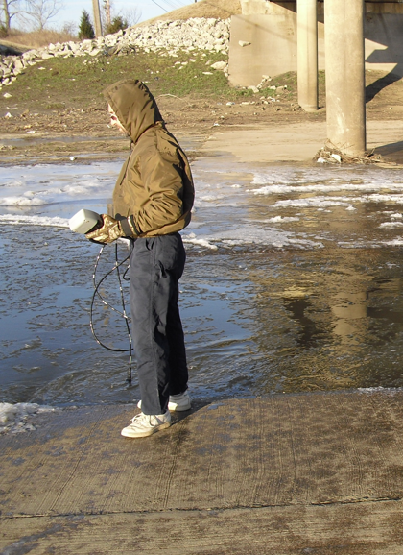
Preparing for 303(d) Inspections
Have SOPs and field forms.
Calibrate instruments.
Proper storage of chemicals, instruments and supplies.
Carry extra batteries, pencils or pens, field forms, etc.
Wear the right clothing and safety gear.
Keep your vehicle well maintained.
Have emergency numbers and addresses and a cell phone.
Work in pairs if possible.
Know how to deal with skeptics and property entry refusal.

Slide 32
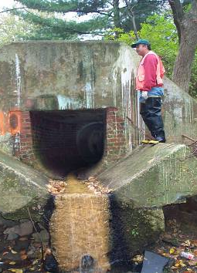
Field Observations
Take notes of all observations of interest.
What are the origins of unusual flow?
What are visual and chemical aspects of the flow?
What is the volume (e.g., gal./min.) of discharge flow?
Colors, odors, soil stains, dead vegetation.
Use “check-box” field forms.
Try not to change data types on forms too much, it causes headaches with analysis.

Slide 33
Field Form Suggestions:
Water velocity (estimated)
Width and depth of water
Color of water
Color of stream bank stains
Odors of the water
Odors within the vicinity
Algae growth
Vegetation (dead or dying)
Trash and debris
Dead animals present
Batteries and chemical waste
Lawn clippings (yard materials)
Barrels and containers
Oily sheen on water
Silt & sediment buildup
Opacity of water
Foam or suds
Land uses in vicinity
Buildings in vicinity
Interviews with neighbors

Slide 34
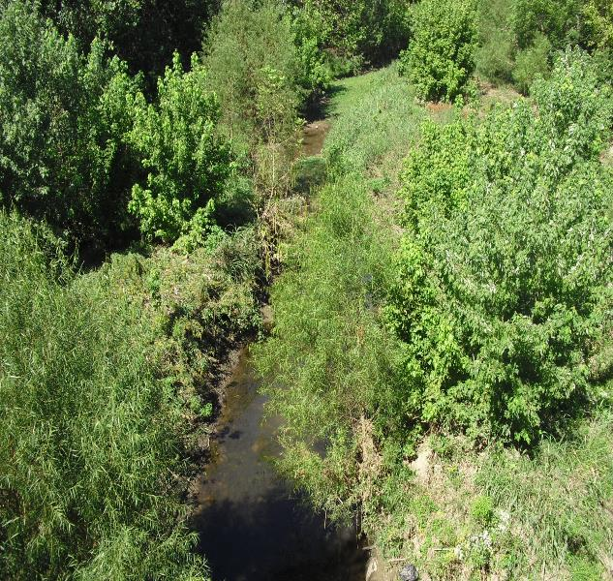
Representative Monitoring
OKR04 Part VI.A.2: “…samples and measurements taken for the purpose of monitoring shall be representative of the monitored activity”
What are your sampling goals?
Does shade make a difference ?
Should you sample pools?
Are pools disconnected (dry stream bed between pools)?
If so, which pool(s) should you sample?
Notes:
This Cat Creek site in Claremore reflects the complexity of site selection found most of the time.
In fact, this is one of the most difficult parts of establishing a sampling program.
Not only must you account for environmental conditions, but safety of field crews, rights of entry onto private property and other factors.
Another example is Childres Creek downstream of Kiefer that is a series of non-flowing disconnected pools of water under base flow conditions.
INCOG performed an Intensive Survey Use Attainability Analysis in 1995 which found each pool having vastly different water quality conditions.
While one pool was very high in conductivity and chlorides from old oil field activities, an adjacent pool was normal. Each pool was different from the other.
So which of all these pools would an MS4 have to select as being “representative” of the entire creek? Actually, no single pool could be considered representative.
In such cases, the MS4 would have to sample a number of pools and if high WQ diversity is found, consider that many pools would have to be sampled.
Representativeness in such cases would then have to be satisfied as the collective WQ condition found overall, not just with one pool.

Slide 35
Addressing TMDLs (Part IV.B)
Complying with OKR04 TMDL requirements

Slide 36
What is a TMDL ?
NOTE: All 2021 OKR04 Table IV-2 TMDLs are for bacteria.
“Total Maximum Daily Load”
Calculates the maximum allowable pollutant loading for a waterbody that will still protect WQS.
All point source loads (WLAs) + all nonpoint source loads (LAs) + a margin of safety (MOS).
Special WLA just for stormwater permittees: “WLA_MS4”
TMDL = ΣWLA + ΣWLA_MS4 + ΣLA + Background + MOS

Slide 37
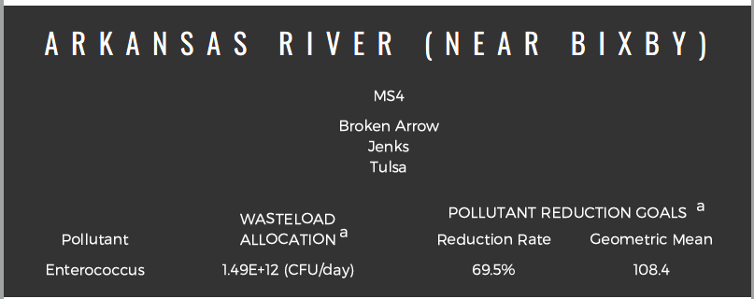
Bacteria TMDLs Overview
Began ~2005 by DEQ staff and DEQ contractors.
Until 2013, TMDLs were “aggregated” for MS4s (a single WLA_MS4 assigned to all MS4s, regardless of proportion).
2014 on, most bacteria TMDLs had individual WLA_MS4s.
TMDL Reports cover multiple watersheds, often include turbidity TMDLs.
OKR04 Table IV-2 lists the 8 TMDL Reports with all MS4s that must address each TMDL in the reports.
DEQ prepared draft summaries of each TMDL Report with WLA_MS4 calculations.

Slide 38
OKR04 TMDL Requirements
OKR04 Part IV.B lists 8 obligations that all Table IV-2 MS4s must meet.
  SWMP review and modification
  TMDL Pollutant Reduction Plan
  TMDL Pollutant Monitoring Plan
  TMDL Baseline Monitoring Plan (optional)
  Monitoring requirements (including QAPP)
  Annual TMDL Implementation Report
  TMDL implementation schedule (Table IV-1)
  Existing approved TMDLs (Table IV-2)
Many MS4s in Table IV-2 have more than one TMDL to comply with.

Slide 39
Table IV-1 TMDL Implementation Schedule
TMDL Activity | Option A (no Baseline Plan) | Option B (Baseline Plan)
SWMP review and evaluation | No more than two years from TMDL effective date
TMDL Pollutant Baseline Monitoring Plan | n/a | No more than three years from TMDL effective date
TMDL Pollutant Reduction Plan | No more than three years from TMDL effective date | No more than 5 years after implementation of the baseline monitoring plan
TMDL Pollutant Monitoring Plan | No more than three years from TMDL effective date | No more than 5 years after implementation of the baseline monitoring plan

Slide 40
OKR04 Table IV-2 TMDLs and MS4s
WATERSHED BASIN | TMDL REPORT | IDENTIFIED MS4 SOURCES
Basin 1 Middle Arkansas-Verdigris-Neosho | Neosho River Basin Bacteria TMDLs-2008 | Miami
 | Lower Bird Creek Watershed Bacteria TMDLs-2011 | Catoosa, Broken Arrow, Owasso, Tulsa, Tulsa County
 | Arkansas River and Verdigris River Area-Bacteria and Turbidity TMDLs-2012 | Bixby, Broken Arrow, Claremore, Coweta, Jenks, Muskogee, Sand Springs, Sapulpa, Tulsa
 | Arkansas River and Haikey Creek Bacteria TMDLs-2008 | Bixby, Broken Arrow, Tulsa, Tulsa County
Basin 5 Canadian-North Canadian-Deep Fork | North Canadian River Area Bacteria TMDLs-2010 | Choctaw, Del City, Midwest City, Moore, Mustang, Nicoma Park, ODOT, Oklahoma City, Oklahoma County, Spencer, Tinker AFB, Yukon
 | Lake Thunderbird Nutrient, Turbidity, and Dissolved Oxygen TMDLs-2013 | Moore, Norman, Oklahoma City
Basin 6 Cimarron-Upper Arkansas | Cimarron River Area Bacteria and Turbidity TMDLs-2012 | Oklahoma City (with ODOT as co-permittee), The Village
 | Salt Fork of the Arkansas River Area Bacteria and Turbidity TMDLs-2011 | Ponca City

Slide 41
OKR04 Monitoring Program Overlap
Why do you go out of the office?
Many sites within your MS4 can have multiple purposes.
The data collected from a site may be useful for meeting more than one OKR04 requirement.
Coordinating 2 or more objectives can be difficult, but beneficial.
Coordination requires in-depth understanding of all monitoring requirements for all program goals.
303(d) Inspections
MCM-3 IDDE Source Tracking
ORW Monitoring
TMDL Monitoring
MCM-3 DWFS Inspections

Slide 42
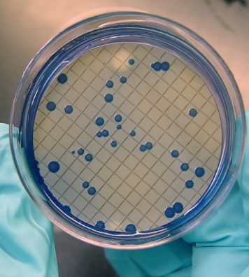
What Are Indicator Organisms?
Water Quality Standards (WQS) are based upon “surrogates”.
Enterococcus and E. coli are “indicator organisms”.
Sources are feces from all warm-blooded mammals.
While some strains are pathogenic, the routine WQ tests do not select for pathogenic organisms.
The presence of “indicators” assumes that there is the potential for pathogens to also be present.
The WQS indicator organisms often are not of human origin nor are they pathogenic.
This Photo by Unknown Author is licensed under CC BY-SA-NC

Slide 43

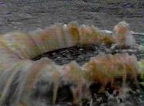
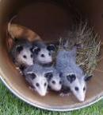

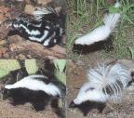

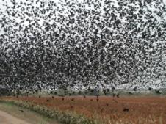
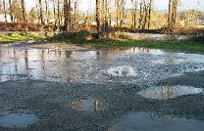

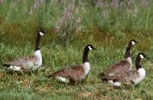


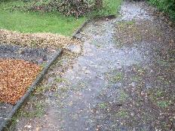




Urban Fecal Organism Sources
Controllable
Partly Controllable
Uncontrollable

Slide 44
Bacteria Concentration Units
Part 136: Membrane Filtration (MF) and Most Probable Number (MPN).
Both MF and MPN are expressed as “per 100 ml” of water sample.
Common bacteria concentration units:
  Col/100 ml Colonies per 100 ml of water sample (MF test)
  CFU/100 ml Colony Forming Units per 100 ml (MF test)
  MPN/100 ml Most Probable Number per 100 ml (dilution series)
EPA approved methods:
  DEQ-certified labs use methods approved in 40 CFR Part 136.
  Part 136.3 Table IH: List of Approved Microbiological Methods for “Ambient Water”.
  Part 136.3 approves both MPN and membrane filtration (MF) methods.

Slide 45

Units Used In 303(d) and TMDLs
TMDL units often expressed as loads in “exponential notation”:
  E.g., 1,000,000 = 1.00 x 10⁶ = 1.00E+06 (where “E” = Exponent)
TMDL Report Table: “Fecal Production (x 10⁹ cfu/day)”
  This means billions of colonies per day.
  Considered a “daily mass load” (TMDL).
  E.g., 135 x 10⁹ cfu/day = 135,000,000,000 cfu/day
TMDL Report Load Table: “4.90E+10 per day”
  Must know how to use exponential notation
  4.90E+10 = 4.90 x 10¹⁰ = 49,000,000,000 cfu/day
Integrated Report and 303(d) use concentration (cfu/100 ml)

Slide 46
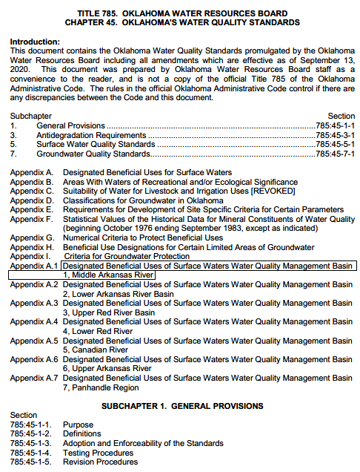
Oklahoma Bacteria WQS
WQS are in Chapter 45 of Title 785 of the Oklahoma Administrative Code (OAC).
Subchapter 5: Surface Water Quality Standards
OAC 785:45-5-16. Primary Body Contact Recreation (PBCR)
  PBCR is “where a possibility of ingestion exists”.
  Numerical criteria for 2 bacteria: E. coli and Enterococcus
  Uses “geometric mean”, not “arithmetic mean”
  Minimum 10 samples collected during “Recreational Period” (May 1 to September 30)
E. coli: 126 col/100 ml (geometric mean)
Enterococcus: 33 col/100 ml (geometric mean)
(Secondary BCR = 5x: E. coli = 630, Enterococcus = 165 col/100 ml)

Slide 47
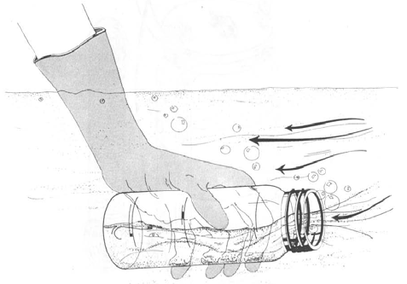
Part 136 Bacteria Sampling Methods
Special 100 ml sampling bottles with labels.
Supplied by lab, along with Chain of Custody Form.
Grab sampling only, no composites. Fill by hand.
Point bottle opening upstream & away from sampler.
Fill bottle 6-12 inches below water surface.
Leave small air space in bottle for mixing in the lab.
Place sample bottles in ice & transport at <10 ºC.
Do not freeze samples or immerse in water.
Preferably deliver to lab within 2 hours of collection.
Maximum holding time: 6 hours of transport to lab.
Maximum 2 additional hours for lab to begin analysis.

Slide 48
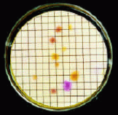
Lab Concentration Expectations
Bacteria concentrations in surface waters can vary by 5x orders of magnitude:
  10 – 100 – 1000 – 10,000 – 100,000 – 1,000,000
The lab must filter enough sample to produce between 20 – 60 colonies on the filter plate for EN (20 - 80 for EC).
Labs set up at least 3 dilutions of each sample to try to get the required plate count range.
Surface water samples are often run at 100 ml, 50 ml, 10 ml and 1 ml.
Past history of each site will help the lab determine their most likely dilution range.

Slide 49
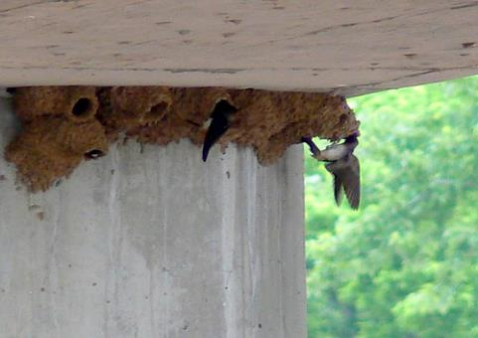
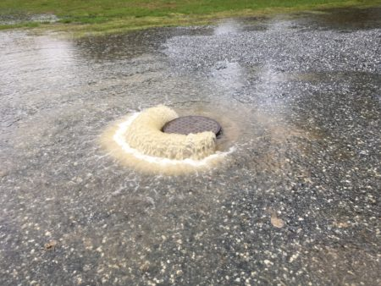
Sampling Condition Diversity
Varying stream size (< 2’ to >20’ width)
Pools with no flow, dry stream bed
Wide rivers, braided flows, shoreline pools
Antecedent stormwater runoff effects
Adjacent land uses and riparian condition
Birds and wildlife
NPDES/OPDES permitted dischargers
Trash, illegal dumping, illicit discharges, SSOs
Field safety, access permission, good data site
These Photos by Unknown Authors are licensed under CC BY-ND

Slide 50
TMDL Monitoring Considerations
DEQ has not yet finalized a TMDL monitoring strategy (numbers of sites, sampling frequency, conditions, methods, etc.)
  Option 1: Each MS4 manages their own program.
  Option 2: Several MS4s join in a “regional” monitoring program.
Part IV.B.5 (TMDL Monitoring Requirements) requires all TMDL monitoring to be under an EPA-based QAPP.
Part VI.A.2 “representativeness”: “…samples and measurements taken for the purpose of monitoring shall be representative of the monitored activity.”
When must TMDL monitoring programs begin?
  Without BLM: TMDL monitoring by 5/31/25.
  With BLM: BLM by 5/31/25, TMDL monitoring by 5/30/30.

Slide 51
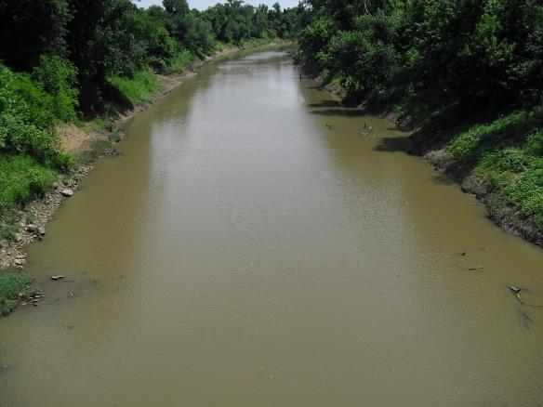


QA Representative Considerations
Representativeness in monitoring is very difficult to achieve. It involves determining the level of data quality needed (DQOs).
What are your sampling goals (DQOs) ?
Account for site conditions: shading, time of day, season, runoff, stream bed, land uses, stream “order” and hydraulics.
Types of streams: pools, riffles, runs…
Intermittent / ephemeral: are pools disconnected (dry stream bed)?
External sources: NPDES dischargers, wildlife, septic tanks, industries, dumping…

Slide 52
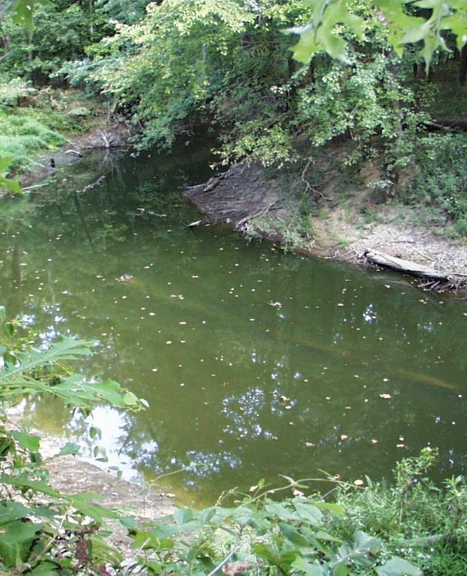
Additional Field Data Needed
Site’s physical description and location, GPS coordinates, photos.
Sampling conditions and problems.
Use forms for visual inspections.
Field measurements: temperature, DO, pH, conductivity, chlorine, etc.
Measure or estimate flow.
Note antecedent rainfall and runoff conditions.
Estimate bacteria concentrations to help the lab set their dilutions.

Slide 53

QA and Training Requirements
TMDL Monitoring Plans require a formal QAPP.
No QAPP is required for other OKR04 sampling, but…. Many benefits!
Use SOPs or other formal written guidance.
No certifications (state, federal or private) are required.
Many organizations offer certified training on sampling; make sure it will be helpful.
GCSA employee training workshops, Zoom meetings and self-teaching modules.
Online materials and information.

Slide 54
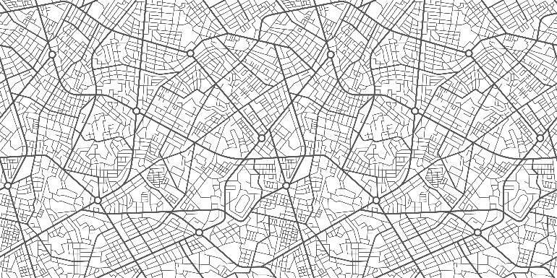
Mapping of Bacteria Sources
What land uses will most likely have bacteria in runoff?
Do you have any within your MS4?
If so, where? Proximity to others? Density?
Areas with history of pollution (e.g., SSOs)?
Local GIS and online mapping (e.g., Google, DEQ Data Viewer).
Paper maps are the least helpful and hardest to maintain.
Pollution sources change frequently, so should your POC source maps.

Slide 55
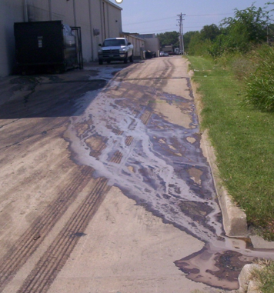
Potential Bacteria Sources
Birds and wildlife, dense riparian, wetlands.
SSOs, lift stations, sewer pipes, manholes.
Residential neighborhoods, detention basins.
Dog parks, fishing ponds, picnic areas.
Restaurant and grocery store trash dumpsters.
Toilets at construction sites and public events.
Farm and ranch shows with live animals.
Homeless encampments, public restrooms (parks).
Bridge crossings over water with nesting birds.
Dead animals and organic waste by bridges.
Older residential areas with old septic tanks.
Animal grazing (cows, horses, poultry, pigs, etc.).

Slide 56
Priority Areas
Creating and using in 303(d) and TMDLs

Slide 57
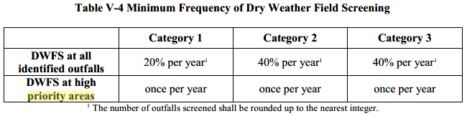
“Priority Area” References in OKR04
Part IV.A.1.d: [303(d)] You must locate those areas likely to have illicit discharges and conduct inspections based on the priority areas in the watershed of your 303(d) listed waterbodies.
Part IV.B.4: [TMDL Baseline Monitoring] The plan should be designed to determine the existing levels of POCs in your MS4’s discharge(s) and identify high priority areas which may benefit from targeted BMPs.
Part V.C.3.a.i [MCM-3] Identify priority areas including areas with a higher likelihood of illicit connections or discharges … Update this priority area list to reflect changing priorities annually.
Part V.C.3.a.v [MCM-3] At a minimum, DWFS shall be conducted at the frequency outlined in Table V-4

Slide 58
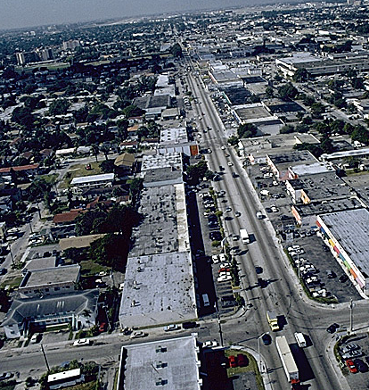
Defining 303(d) and TMDL POC Source Priority Areas
OKR04 does not specify how to define priority areas.
OKR04’s “priority areas” apply to 303(d), TMDLs and MCM-3 IDDE program.
Try defining Priority Areas using a DQO process:
(what info is needed, by whom, and how will the info be used?)
Use a combination of field visual data and map info.
Know your MS4 area and the potential for certain land uses to contribute bacteria in runoff.
Don’t make the entire 303(d) / TMDL watershed a PA.
Evaluate only those parts that have the greatest pollution potential.

Slide 59
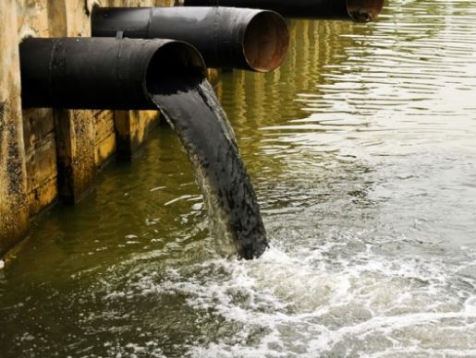
Important In Source Identification
Use the same Priority Area concepts as in MCM-3 IDDE “Source Tracking”.
Many Illicit Discharge sources are obvious and easy to find; others are not:
  VISUAL: Flowing pipes, trickle channels, sheet flows (track upstream).
  CHEMISTRY: measure / test kit data upstream of site for chemical presence.
  LOCALIZED EPISODIC: only a single location with no indicators of what, when, or by whom. May only be dead vegetation, stains or odors (no chemicals present).
PRP (Principal Responsible party) may be easy to identify, or perpetrator may never be found (e.g., illegal dumping).
This Photo by Unknown Author is licensed under CC BY-NC-ND

Slide 60

Maps Are Essential For Data & Strategies
Paper maps have serious limitations:
  Difficult to produce and use.
  Difficult to make frequent changes and updates.
  No images for reports, files or internet sharing.
GIS maps are easier to update and maintain.
Wide variety of data associated with GIS map features.
GIS drawbacks:
  Software learning curve is huge.
  Costly (initial purchase and annual fees) (Q-GIS?)
  GIS layers often have errors; difficult to correct.
  GIS layers can be outdated and not refreshed.
  Metadata needed to confirm latest version.

Slide 61



Questions ?
Vernon Seaman
Manager, Envir. and Energy Planning
INCOG
Two West 2nd Street, Ste 800
Tulsa, OK 74103
(918) 579-9451
vseaman@incog.org

